Slide 1
Control Variables and Control Groups

Slide 2

By the end of this Smart Lesson about control groups and variables you should be able to:
• | Identify what a control variable is.
• | Describe why control variables are important.
• | Identify what a control group is.
• | Describe why control groups are important.

Slide 3

Experiments are a way to answer questions about cause and effect.
We do experiments to find out how changing one variable causes a change in another variable.
For example, how does changing the temperature affect the rate of an ice cube melting?

Slide 4
The time the ice cube takes to fully melt into water is the variable the experimenter is measuring.
The temperature of the ice cube is the variable the experimenter is changing.
But how do we know that temperature is the only variable causing the ice to melt faster?

Slide 5
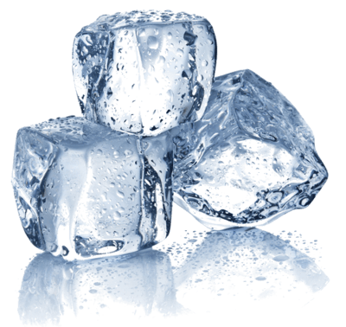
We need to be careful about our variables.
In order to conduct a good experiment, we need to make sure that the variable that we are changing (temperature) is the only thing having an effect on what we are measuring (rate of melting).
To do this, we need to make sure other variables (like the mass of the ice cube) are kept the same for each test.

Slide 6

This is known as a control variable.
A control variable is something that the experimenter keeps constant (controls) so that it does not affect the outcome of the experiment.
An experiment aims to answer a question about cause and effect, but if there are multiple causes (e.g. temperature AND mass), the experiment will likely answer the question incorrectly.

Slide 7
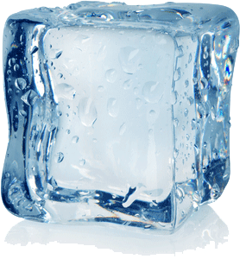
For example:
In your experiment, you might find that a small ice cube kept at 18∘C melts faster than a large ice cube kept at 20∘C.
According to these results, it could be concluded that ice cubes melt faster at lower temperatures!

Slide 8
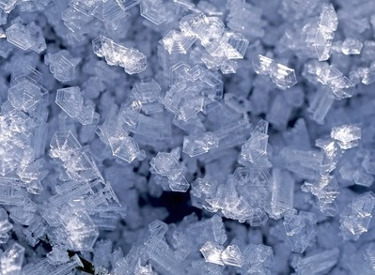
Temperature was not the only variable affecting the speed of melting.
Because the mass of the ice cubes was not kept constant, the mass also affected the rate of melting.
This means that the conclusion that ice cubes melt faster at lower temperatures was incorrect.

Slide 9

The mass of the ice cubes needs to be kept constant throughout the experiment.
The mass is therefore a control variable.
Control variables are necessary to make sure that you get valid results, and therefore come to the correct conclusion about what your results mean.

Slide 10
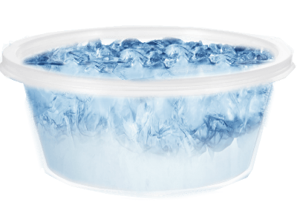
In science we want to answer questions.
You may want to know if ice cubes melt faster at 45∘C than at room temperature.
You could conduct an experiment to answer this question.

Slide 11
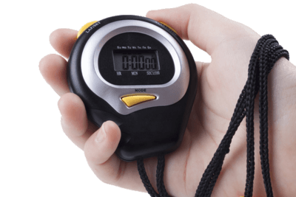
So how do we test this?
You could put an ice cube under 45∘C heat and time how quickly it melted.
It might melt quickly, but you couldn't say it melted faster than normal (room temperature, 25∘C), unless you had directly compared the two temperatures.

Slide 12
In every experiment we need a control.
To see whether an ice cube in 45∘C heat melts faster than at room temperature, you could use a control group.
A control group is a different group of ice cubes (or group of subjects). It provides a baseline measure that can be used as a comparison.
A control group is NOT subjected to any independent variables. This means that the experimenter does nothing to it.

Slide 13
So, what is our control in this instance?
In our experiment, you would apply 45∘C heat to the experimental group of ice cubes, and the rate of melting of this group could be compared to another group of ice cubes that you left sitting on the bench at room temperature.
The group of ice cubes left on the bench would be classified the control group.

Slide 14
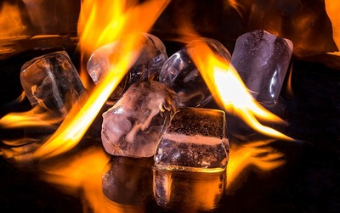
The group of 'control' ice cubes provides a comparison to any other ice cube groups that you choose to manipulate.
If a group of ice cubes, in 45∘C heat, melts completely to water in an average of 50 seconds, it means nothing unless we know that this is in comparison to a group of ice cubes, at room temperature, that melts fully in an average of 3 minutes.

Slide 15
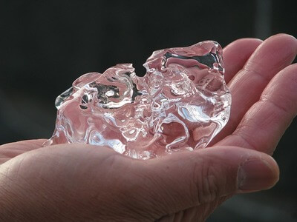
A control group allows us to see that there is a change in our subject (ice cubes) due to our independent variable (heat).
This is meaningful when compared to non-experimental conditions.

Slide 16

The control group is kept under the same conditions as the experimental group.
For example: The ice cubes should be kept in the same environment, be the same size and mass, and be made from the same source of water.
The only difference is the control group is not subject to the variable of interest (high temperatures).

